Slide 1
Blinkit Analysis
An analysis of outlet size, location, establishment year and revenue trends

Slide 2



HOW TO ORIGION

Slide 3
Introduction
This presentation analyzes Blinkit's performance based on key factors such as outlet size, geographical location, and establishment year. We will explore revenue trends, operational efficiency, and market growth to derive business insights for strategic decision-making.
Problem statement

Slide 4
KEY POINTS
:-An analysis of outlet size
:- An analysis of location,
:- An analysis of establishment year
:- An analysis of revenue trends

Slide 5
Categorization of outlets by size
Outlets are categorized into three main sizes: small, medium, and large. This classification helps analyze their performance metrics distinctively. Each category behaves differently in terms of customer reach, service offerings, and overall operational capacity, influencing how Blinkit operates in diverse markets.

Slide 6
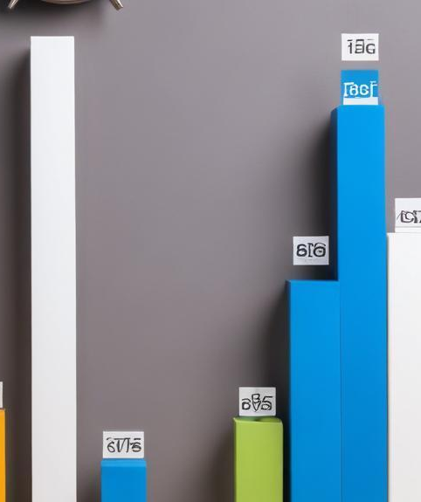
Comparison of order volume and revenue of sales
An analysis of order volumes across different outlet sizes reveals significant trends. Small outlets may handle a higher number of orders but often experience longer delivery times due to limited resources. In contrast, larger outlets, while managing vast order volumes, can optimize delivery time through robust logistical support, indicating the need for strategic adjustments in operations.

Slide 7
Efficiency metrics across outlet sizes
Efficiency metrics are crucial for assessing how well each outlet size operates. Small outlets may showcase higher order frequencies but struggle with service speed due to inventory limitations. Medium-sized outlets often strike a balance, having more resources than small ones without the overhead of large facilities. Large outlets typically benefit from economies of scale, allowing for faster processing times and better resource allocation, resulting in improved delivery performance and customer satisfaction.

Slide 8
Total sales and avg sales
Market trends on the basis of different aspects wise analysis

Slide 9
Sales trends by city and tier
Sales trends show significant variances between metro and non-metro locations. In metro areas, sales typically outperform due to higher population density and consumer demand for rapid delivery services. Conversely, non-metro city sales may be stable but grow at a slower pace. Understanding these trends aids in tailoring marketing strategies and resource allocation to maximize revenue opportunities in each tier.

Slide 10
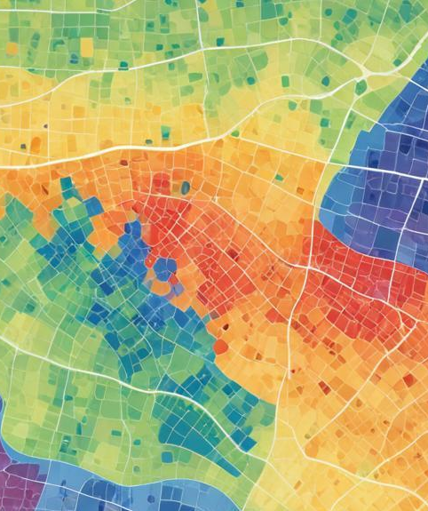
Patterns of customer demand in various locations
Customer demand patterns fluctuate based on location demographics. In urban centers, demand tends to peak during specific hours, particularly around lunch and after work hours. Seasonal variations further affect customer preferences, with certain products performing better during holidays or local events. Analyzing these patterns helps optimize inventory management and marketing efforts catered to specific regions.

Slide 11
Impact of location presence on revenue
The presence of outlets in urban versus suburban areas directly impacts revenue generation. Urban establishments enjoy higher foot traffic and consumer spending but may face stiffer competition. Suburban outlets, in contrast, often cater to a loyal customer base looking for convenience. Strategic investments in both areas can balance the risk and rewards associated with distinct consumer behaviors, ultimately enhancing Blinkit's market presence.

Slide 12
Conclusions
The analysis reveals that effective categorization of outlet sizes and a keen understanding of location dynamics are essential for Blinkit's sustained growth. Tailored strategies for different outlet sizes and market tiers can substantially enhance operational efficiency and revenue streams. Adapting to localized customer demands and optimizing resource distribution are critical for future success.

Slide 13
Thank you!
Do you have any questions?
DATASET AND DASHBOARD FOR PERMORMENCE
Please keep this slide for attribution
DATASET AND DASHBOARD FOR PERMORMENCE

